Slide 1

Theory of computations
Project stoplight

Slide 2




Group members
Tenoy Genus – 1503263
Jordan Murray – 1503454
Vernon Bailey – 1500365

Slide 3
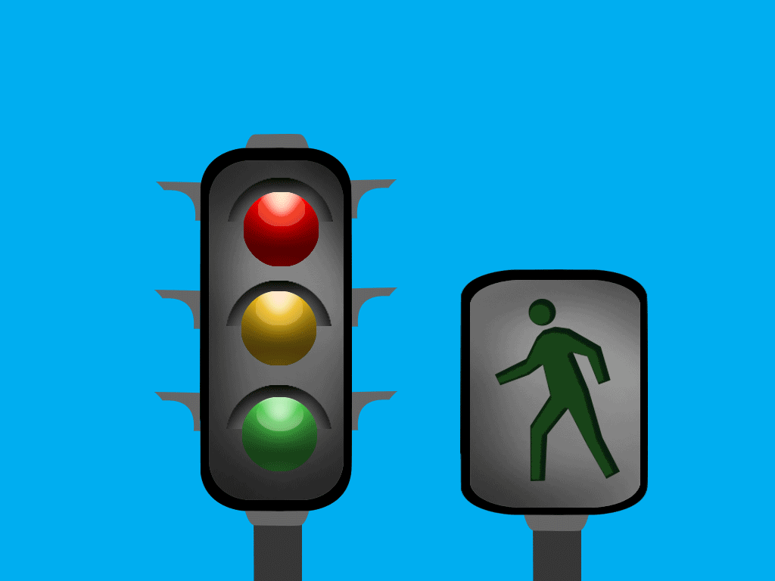
introduction
What is a stoplight? – According to the Collins dictionary, a stoplight is a set of coloured lights which controls the flow of traffic on a road. The colours used for a stoplight are usually red, green and amber with red meaning stop, amber meaning prepare to stop and green means you can go. Stoplights can vary depending on the country you are in and so not every stoplight will be the same.

Slide 4
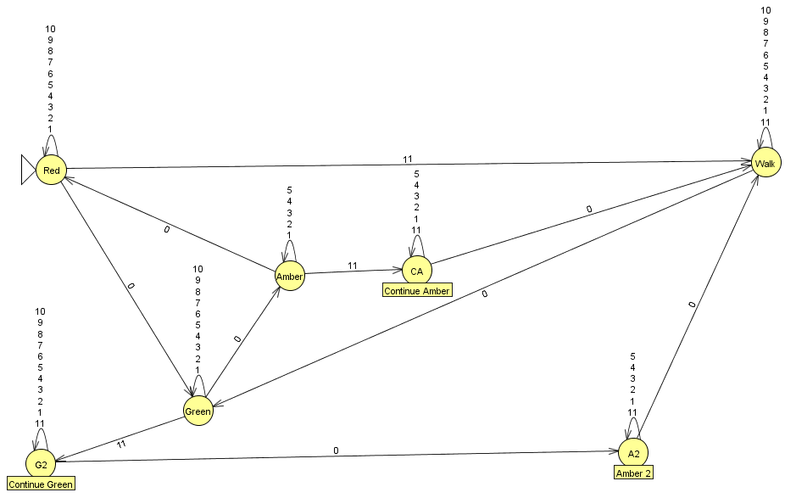
Our state diagram - Dfa

Slide 5
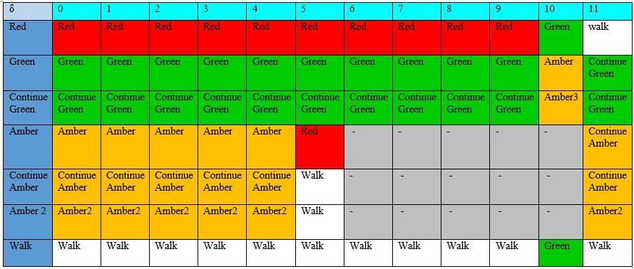

Formal description
$$M=(Q, ∑, δ, q0, F)$$
Q = {Red,Green,Continue Green,Amber,Continue Amber,Amber2,Walk}
$∑$= {0,1,2,3,4,5,6,7,8,9,10,11}
$δ$ = $Q x ∑$

Slide 6

Formal description Cont’d
$$M=(Q, ∑, δ, q0, F)$$
$q0$ = Red
$F$ = $\{ø\}$

Slide 7

Formal set description notation
$∑ = \{0,1,2,3,4,5,6,7,8,9,10,11\}$
$L=\left\{ w \right| w=0 or w=1 or w= 2 or w=3 or w= 4 or w= 5 or w= 6 or w= 7 or w= 8 or w= 9 or w=10 or w=11,w∈∑\}$

Slide 8
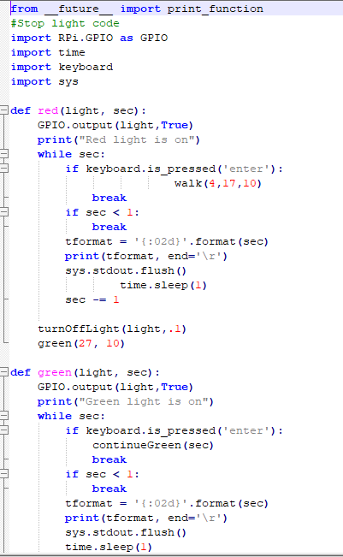
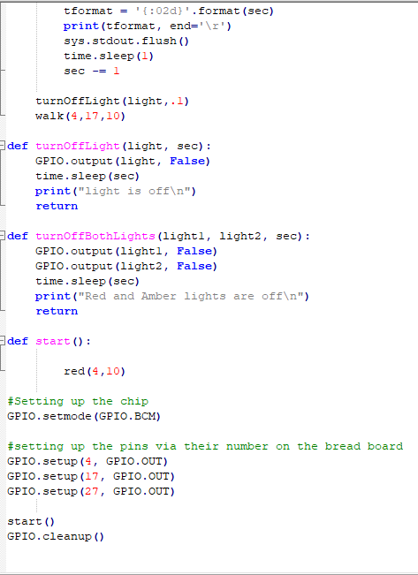
Code Snippet

Slide 9
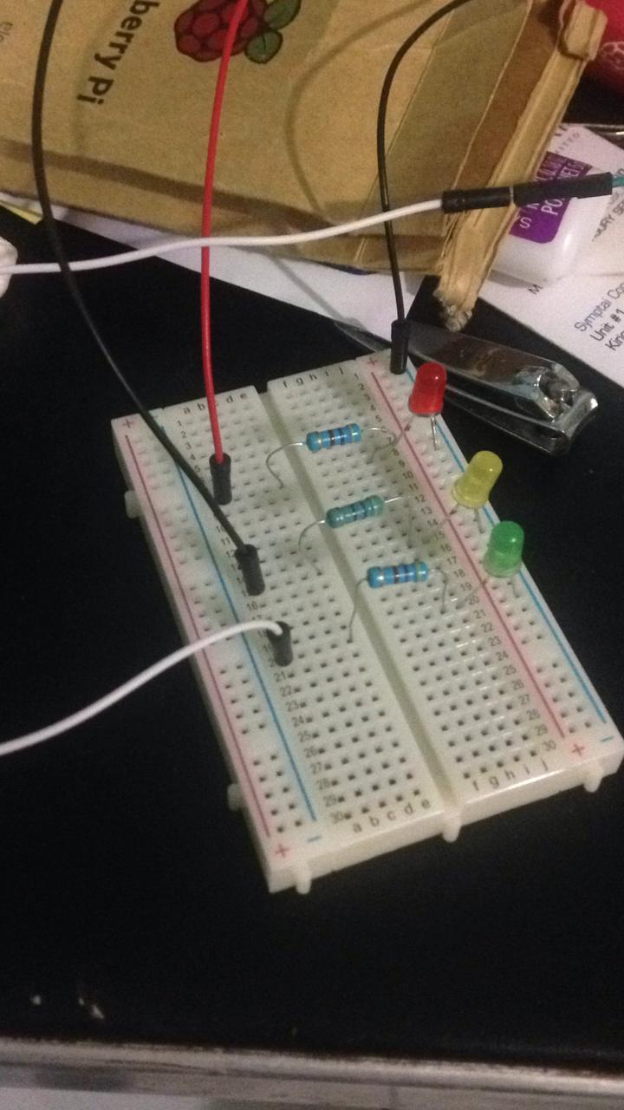
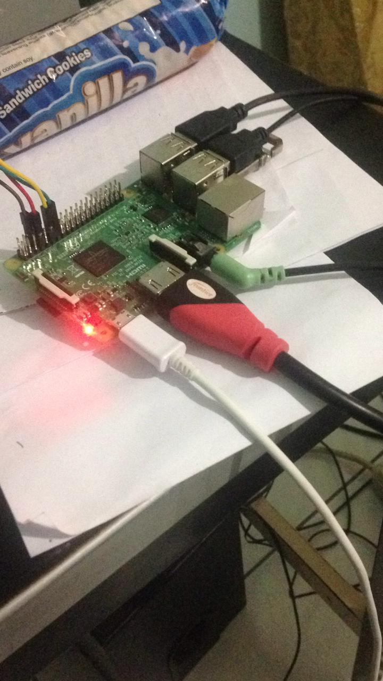
Diagram of set up

Slide 10

Be careful – this can happen if you try to beat a light

